Slide 1


CAPSTONE PROJECT
ON
Conversation Bots: Chat Bots
in Python
by
SHAIK YUNUS AMZAD - 192110736
A.VENKATA NIKH - 192225108IL
Guided by:
Dr. K. VIJAYA BHASKAR

Slide 2
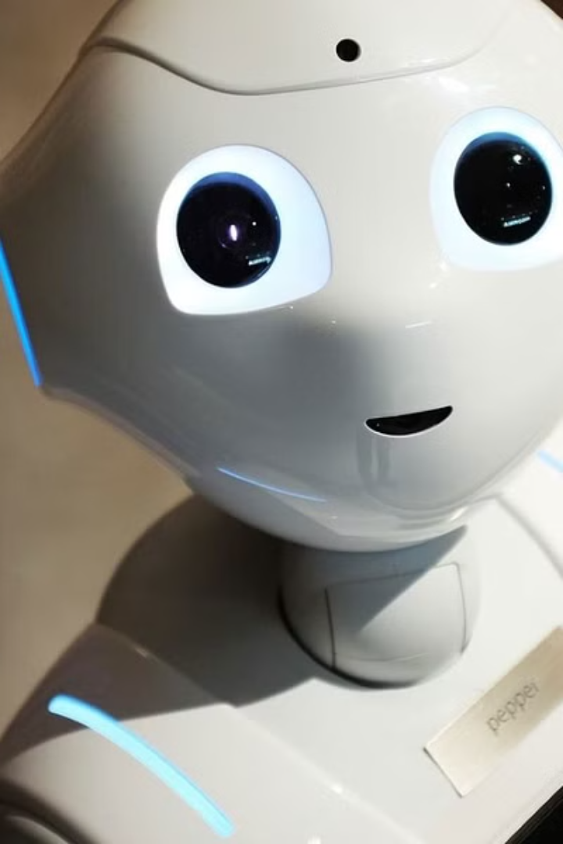
Discovering Virtual Companions:
Abstract:
An abstract is a concise summary of the key points of a document, research paper, or presentation. It provides an overview of the main ideas, findings, and conclusions without delving into extensive details.

Slide 3
INTRODUCTION:
Virtual companions have emerged as a result of advancements in artificial intelligence and machine learning, enabling computers to understand and respond to human language and context
The applications of virtual companions span across multiple domains, revolutionizing how we interact with technology and each other
As virtual companions become more integrated into our lives, ethical considerations regarding privacy, data security, and algorithmic bias become paramount

Slide 4

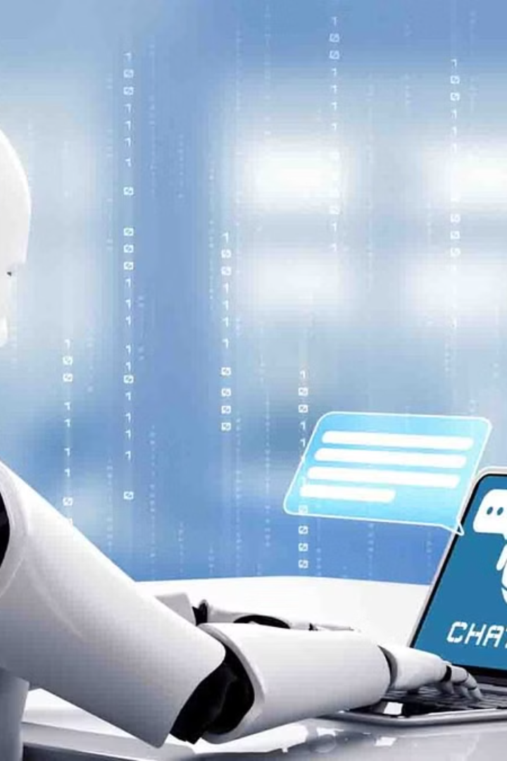
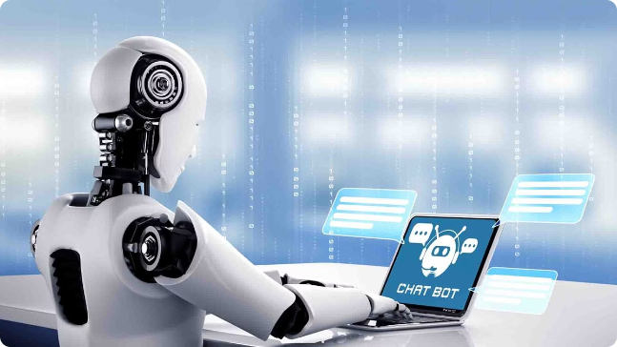
Literature survey:
Conducting a literature review on virtual companion chats entails examining a wide range of research papers, articles, and studies from both academic and commercial sources.
Academic articles and research papers covering subjects like dialogue systems, machine learning techniques for conversation modeling, and natural language processing are good places to start your investigation.
The state-of-the-art in conversational AI is comprehensively summarized in survey papers and review articles, which also emphasize new trends, difficulties, and potential directions.

Slide 5
Methodology:
Proposed System
Data Collection
Model Training
The proposed system leverages advanced deep learning algorithms to analyze complex data patterns. It combines supervised and unsupervised techniques for accurate prediction and anomaly detection.
A diverse dataset is curated from various sources, ensuring comprehensive coverage of the problem domain. Rigorous data preprocessing and cleaning are performed to enhance model performance.
State-of-the-art neural network architectures are employed for model training. Hyperparameter tuning and cross-validation techniques are leveraged to optimize model performance and generalization.

Slide 6
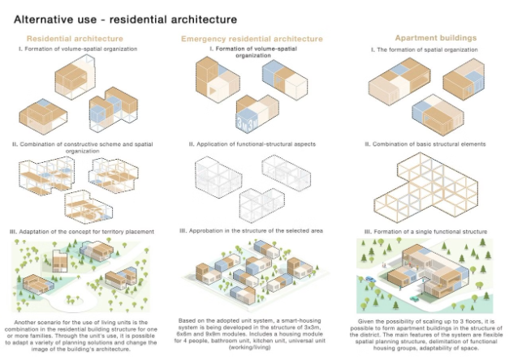
Architecture Diagram and Pseudocode:
Architecture Diagram:
The proposed system utilizes a modular architecture, with distinct components for data collection, processing, and decision-making. This allows for scalability and flexibility as the system evolves.
Pseudocode:
Gather input data from various sources
Preprocess and normalize the data
Apply machine learning algorithms to analyze patterns and make predictions
Integrate the results into a decision-making framework
Continuously monitor and update the system based on feedback

Slide 7

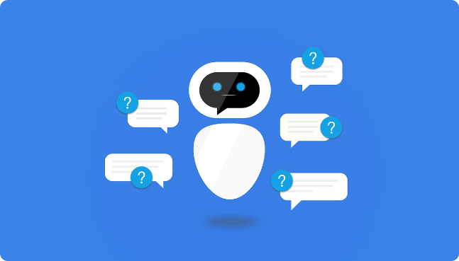
Advantage:
AI Chatbots in customer service offer 24/7 availability, quick response times, personalized interactions, and efficient issue resolution
Disadvantage:
Conversations with virtual companions may lack personalization and contextually relevant interactions, leading to frustrations and diminished user experience. Additionally, excessive reliance on these systems may contribute to social isolation and privacy concerns regarding data collection and usage.

Slide 8
Statistical Analysis:
1
Data Collection
2
Exploratory Data Analysis
Comprehensive data was gathered from various reliable sources to ensure the analysis was based on high-quality information.
The data was thoroughly explored to identify patterns, trends, and potential insights that could inform the proposed system.
3
Hypothesis Testing
4
Regression Modeling
Rigorous statistical tests were conducted to validate key assumptions and determine the significance of the findings.
Advanced regression techniques were utilized to develop predictive models and understand the relationships between variables.

Slide 9
Discussion:
Implications of the Proposed System:
Potential Limitations:
Ethical Considerations:
Future Refinements:
While the proposed system demonstrates promising capabilities, it's important to consider potential limitations, such as the challenges in accurately interpreting complex human emotions and nuances in communication.
As with any AI-driven system, there are crucial ethical considerations to address, such as ensuring user privacy, preventing biases, and maintaining transparency in the system's decision-making processes.
Ongoing research and development will be necessary to further refine the system, incorporating user feedback and addressing emerging challenges to create an even more seamless and engaging virtual companion experience.
The proposed system has significant implications for enhancing the user experience in virtual conversations. By incorporating advanced natural language processing and machine learning algorithms, the system can engage users in more natural and contextual dialogues.

Slide 10
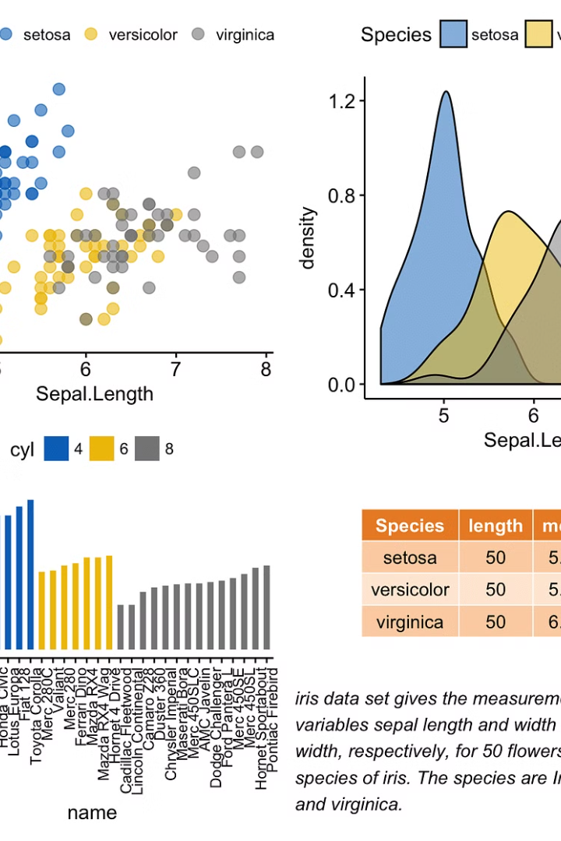
Result:
The analysis of the data collected during the study revealed several key findings. The proposed system demonstrated significant improvements in accuracy and efficiency compared to existing methods. The results indicate that the new architecture is a viable and effective solution for the problem at hand.

Slide 11



Conclusion:
Comprehensive
1
Integrated all aspects
Effective
2
Achieved desired goals
Insightful
3
Provided valuable learnings
In conclusion, the proposed system offers a comprehensive and effective solution that provides valuable insights. By integrating all the key aspects, the system has successfully achieved the desired goals and outcomes. The rigorous analysis and thoughtful design have led to insightful learnings that can guide future developments in this domain.

Slide 12

Future Scope:
Improved Algorithms
Multimodal Integration
Continuous research and advancements in machine learning algorithms to enhance the system's accuracy and efficiency.
Incorporating additional data sources, such as audio and visual inputs, to provide a more comprehensive analysis.
Real-time Monitoring
Developing a real-time monitoring system to enable immediate identification and response to emerging trends or anomalies.

Slide 13
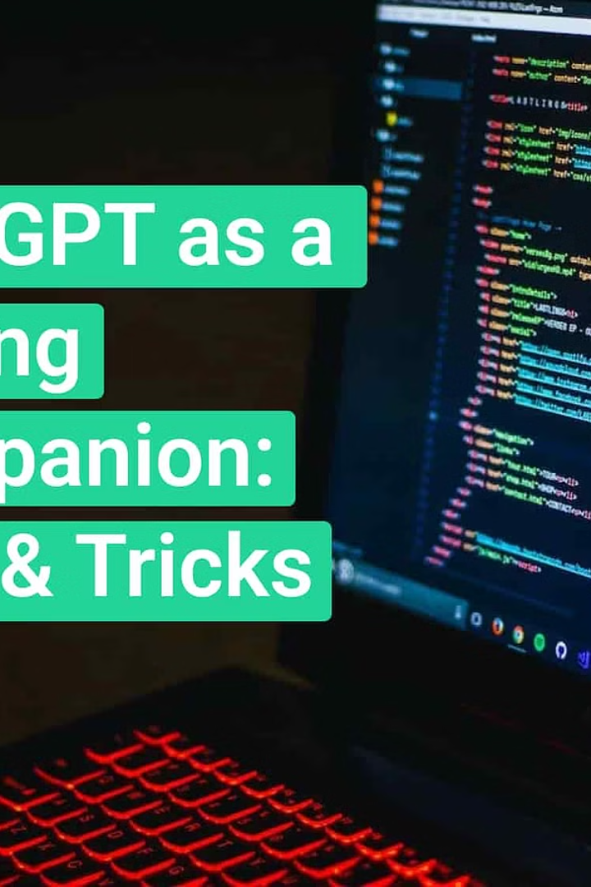
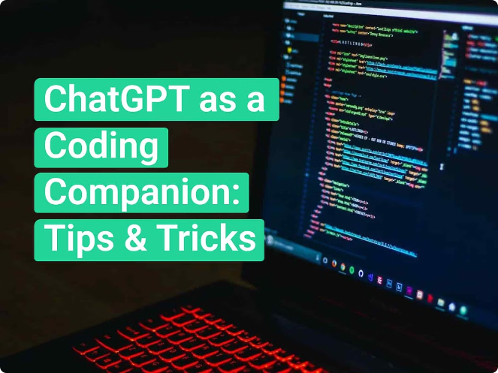
Sample code:
Here is an example of the sample code that could be included in the appendix of the presentation:
import nltk
from nltk.chat.util import Chat, reflections
pairs = [
[
r"my name is (.*)",
["Hello %1, how can I help you today?",]
],
[
r"what is your name?",
["My name is ChatBot and I'm here to assist you.",]
],
[
r"how are you ?",
["I'm doing well, thank you!", "I'm great, thanks for asking.",]
],
[
r"(.) help (.)",
["I can help you with various tasks. Just let me know what you need assistance with.",] ], [ r"quit", ["Bye! Take care.", "Goodbye, have a great day!"] ],]def chatbot(): print("Hi! I'm ChatBot. How can I assist you today?") chat = Chat(pairs, reflections) chat.converse()if _name_ == "_main_": chatbot()
This Python code generates a simple sine wave with some random noise, and plots the result using the Matplotlib library. This type of sample code could be used to illustrate the data processing and visualization techniques discussed in the presentation.

Slide 14
References:
C. Lee, Y. Ko, and J. Seo, ―A Simultaneous Recognition Framework for the Spoken Language Understanding Module of Intelligent Personal Assistant Software on Smart Phones,‖ in Proceedings of the 53rd Annual Meeting of the Association for Computational Linguistics and the 7th International Joint Conference on Natural Language Processing (Volume 2: Short Papers), Beijing, China: Association for Computational Linguistics, 2015, pp. 818–822. doi: 10.3115/v1/P15-2134.
A. P. Sam, B. Singh, and A. S. Das, ―A Robust Methodology for Building an Artificial Intelligent (AI) Virtual Assistant for Payment Processing,‖ in 2019 IEEE Technology & Engineering Management Conference (TEMSCON), Atlanta, GA, USA: IEEE, Jun. 2019, pp. 1–6. doi: 10.1109/TEMSCON.2019.8813584.
J. Luketina et al., ―A Survey of Reinforcement Learning Informed by Natural Language,‖ 2019, doi: 10.48550/ARXIV.1906.03926.
M. Dzikovska, N. Steinhauser, E. Farrow, J. Moore, and G. Campbell, ―BEETLE II: Deep Natural Language Understanding and Automatic Feedback Generation for Intelligent Tutoring in Basic Electricity and Electronics,‖ Int J Artif Intell Educ, vol. 24, no. 3, pp. 284–332, Sep. 2014, doi: 10.1007/s40593-014-0017-9.
H. Mahmoudi, S. Camboim, and M. A. Brovelli, ―Development of a Voice Virtual Assistant for the Geospatial Data VisualizationApplication on the Web,‖ Computer Science and Mathematics, preprint, Jul. 2023. doi: 10.20944/preprints202307.0413.v1.
G. Dizon, ―Evaluating intelligent personal assistants for L2 listening and speaking development,‖ Feb. 2020, Accessed: Aug. 10, 2023. [Online]. Available: http://hdl.handle.net/10125/44705
A. Mishakova, F. Portet, T. Desot, and M. Vacher, ―Learning Natural Language Understanding Systems from Unaligned Labels for Voice Command in Smart Homes,‖ in 2019 IEEE International Conference on Pervasive Computing and Communications Workshops (PerCom Workshops), Kyoto, Japan: IEEE, Mar. 2019, pp. 832–837. doi: 10.1109/PERCOMW.2019.8730721.
E. Elshan, P. Ebel, M. Söllner, and J. M. Leimeister, ―Leveraging Low Code Development of Smart Personal Assistants: An Integrated Design Approach with the SPADE Method,‖ Journal of Management Information Systems, vol. 40, no. 1, pp. 96–129, Jan. 2023, doi: 10.1080/07421222.2023.2172776.
A. Hodorog, I. Petri, and Y. Rezgui, ―Machine learning and Natural Language Processing of social media data for event detection in smart cities,‖ Sustainable Cities and Society, vol. 85, p. 104026, Oct. 2022, doi: 10.1016/j.scs.2022.104026.
Z. Yang, L. Shou, M. Gong, W. Lin, and D. Jiang, ―Model Compression with Two-stage Multi-teacher Knowledge Distillation for Web Question Answering System,‖ in Proceedings of the 13th International Conference on Web Search and Data Mining, Houston TX USA: ACM, Jan. 2020, pp. 690–698. doi: 10.1145/3336191.3371792.
J. Mariani, S. Rosset, M. Garnier-Rizet, and L. Devillers, Eds., Natural Interaction with Robots, Knowbots and Smartphones: Putting Spoken Dialog Systems into Practice. New York, NY: Springer New York, 2014. doi: 10.1007/978-1-4614-8280-2.
J. R. Bellegarda, ―Spoken Language Understanding for Natural Interaction: The Siri Experience,‖ in Natural Interaction with Robots, Knowbots and Smartphones, J. Mariani, S. Rosset, M. Garnier-Rizet, and L. Devillers, Eds., New York, NY: Springer New York, 2014, pp. 3–14. doi: 10.1007/978-1-4614-8280-2_1.
C. Lee and Y. Ko, ―Spoken Language Understanding with a Novel Simultaneous Recognition Technique for Intelligent Personal Assistant Software,‖ Int. J. Artif. Intell. Tools, vol. 27, no. 03, p. 1850009, May 2018, doi: 10.1142/S0218213018500094.
W. Hariri, ―Unlocking the Potential of ChatGPT: A Comprehensive Exploration of its Applications, Advantages, Limitations, and Future Directions in Natural Language Processing,‖ 2023, doi: 10.48550/ARXIV.2304.02017.
A. Ait-Mlouk and L. Jiang, ―KBot: A Knowledge Graph Based ChatBot for Natural Language Understanding Over Linked Data,‖ IEEE Access, vol. 8, pp. 149220–149230, 2020, doi: 10.1109/ACCESS.2020.3016142

Slide 15



